Slide 1
VP160 Recitation Class 9
by Li Chunchao
2016/8/2

Slide 2
Short Review

Slide 3

Rigid body
Equilibrium
Center of gravity

Slide 4
Elasticity
Stress, strain, and elastic moduli
Elasticity Hooke's law

Slide 5
Liquid mechanics
Pressure at depth
Pascal's law
Absolute pressure and gauge pressure
Buoyancy and Archimedes's law
Ideal liquid
Surface Tension
Bernoulli's Equation

Slide 6
Gravitation
gravitational force
potential energy and potential
motion of satellites

Slide 7
Solving Problems

Slide 8
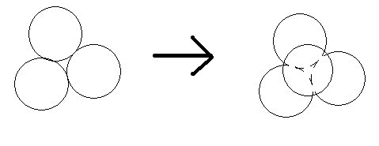
Rigid body
There is four identical ball laying as following. The friction coefficient is the same everywhere. Find the range of friction coefficient.

Slide 9
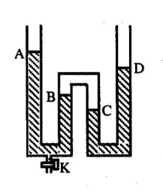
Liquid mechanics
After release some liquid by open the valve, the height of liquid change ΔA, ΔB, ΔC. Find the sign and the magnitude relationship between them.

Slide 10
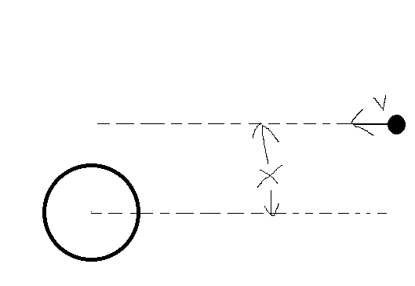
Gravitation
If there is a stone fly from very far place to the earth as the following picture. How fast should the stone fly at very far place if it will not fall on the earth. The Mass of earth is M. The radius of earth is R.

